Slide 1
Securing Our Future Initiative: FY20 Updates and Accomplishments

Slide 2
BIRTH TO 22 ACTION AREAS ECONOMIC ACCESS
Mitigate the impact of poverty on youth
Increase affordability of basic services
Build education to employment pathways for disconnected youth
Notes:
In March through May 2016, the Birth to 22 Alliance hosted a series of community conversations to identify barriers to living a fulfilling life for parents and children in our community. These community conversations led to the creation of the Youth Master Plan. Through that plan, using the community conversations as a guiding tool, 6 action areas were created with the intention of creating opportunities for youth to excel in life. One of the barriers identified by the community conversations was economic access. The Youth Action Plan identified three primary targets to increasing economic access to youth in our community. These targets are listed above.
To address these targets, SOFI was created.

Slide 3
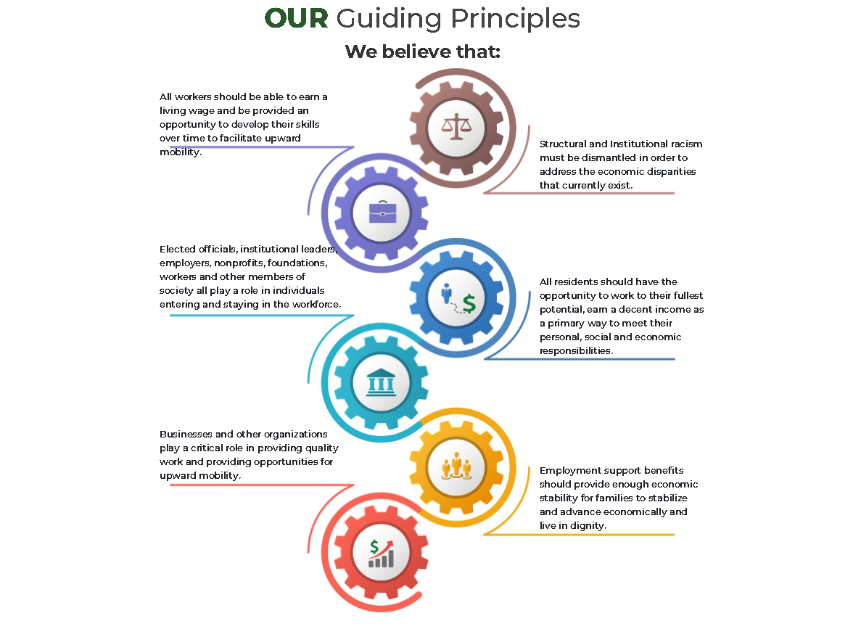
SOFI Guiding Principles
Notes:
VISION A System of Care that maximizes opportunities for economic mobility.
MISSION To collaborate with community stakeholders to create an ecosystem that supports innovative systemic change leading to increased economic mobility for low-income families.
GOAL To reduce poverty by 10% over the next 10 years by moving 188 households (with children ages 0–18) beyond the federal poverty threshold (and eventually the living wage or ALICE threshold) every year for the next decade.
FRAMEWORK TO ACHIEVING ECONOMIC MOBILITY THROUGH GAINFUL EMPLOYMENT
Provide support benefits to help families meet their basic needs and increase financial stability while improving individual life skills, building human and social capital and creating opportunities for personal and professional growth.
Develop partnerships that strengthen our local ecosystem to offer skill building, mentorship and career exposure for youth and adults to facilitate more on-ramp quality employment opportunities.
Develop a local, state and federal policy agenda that reduces barriers to employment for low-income households and vulnerable populations.

Slide 4
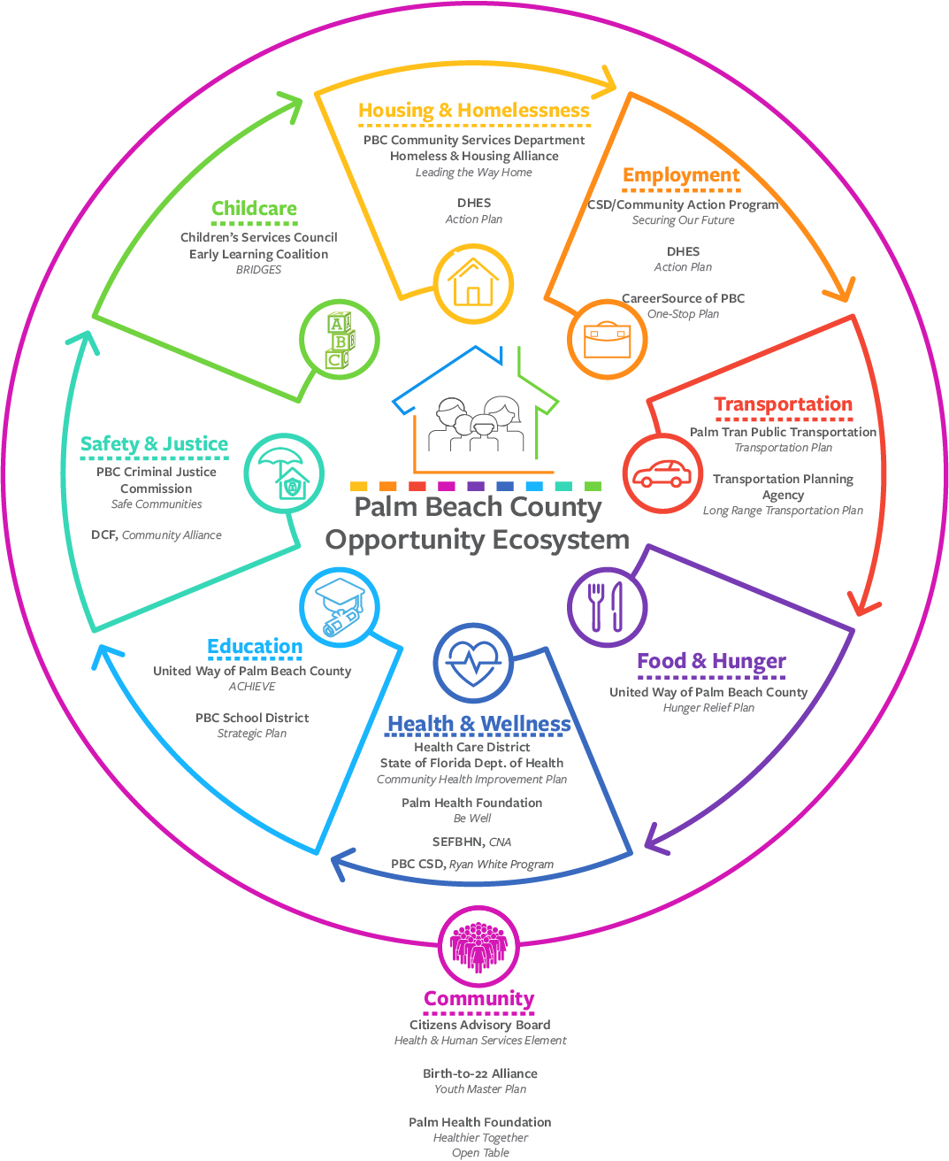
GOALS OF SECURING OUR FUTURE
Decrease childhood poverty by 10% over 10 years
Create an opportunity ecosystem across different sectors that eliminates barriers that prevent low-income families in becoming more self-reliant
Notes:
We see poverty as a continuum. We strive to support families in steps on the continuum. First, we support a family to get from 100% to 200% and higher of the FPLG. Then once they achieve that goal, we support them to earn more, moving them into the ALICE category. While in the ALICE category, our opportunity ecosystem would continue to provide services that our families may no longer qualify for such as food assistance, and childcare due to the fiscal cliff. Families participating in SOFI will continue through the initiative until they are well beyond making a living wage, when they feel secure and financially independent.
In order to decrease poverty by 10% over the next 10 years, we aim to have 188 participating families a year. FY20 was our pilot year. We anticipate the number of families participating to exponentially increase as each year we bring on new families while continuing to assist families from prior years.
The goal of the ecosystem is to have a collective of agencies that provide priority services or “fast pass” services to our SOFI participants. All of our participants struggle with barriers to financial independence and even more barriers accessing services that are intended to remove barriers to financial independence. This “Disney-Line” concept would provide priority access for our SOFI families to services with organizations within the opportunity ecosystem.

Slide 5
TIMELINE

Slide 6
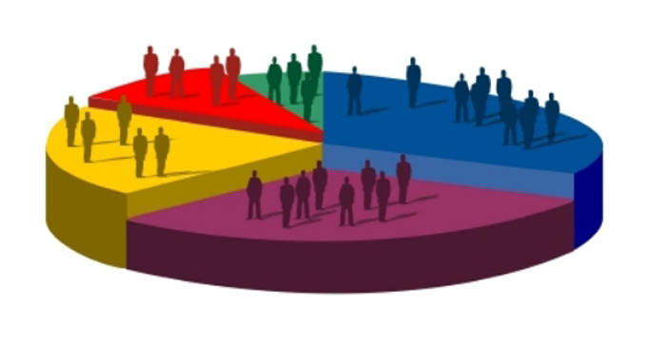
DEMOGRAPHICS
Notes:
FY20 was the first year of this initiative and gave us a lot of really strong baseline data.

Slide 7
191 Individuals
Notes:
Through our racial equity work, we’ve been able to identify some of the biggest gaps are in our black and African American communities. In our community, black and African American communities are disproportionately affected by poverty. It is this population that we focused our services on in FY20. We seek to provide an opportunity eco-system that will provide the specialized services that are needed in the black and African American communities. We do this by talking to the community to identify what their specific needs are and connecting them with the ecosystem to eliminate those barriers. As mentioned before, the ecosystem is designed to be a “fast pass” to services. This is especially important for our black and African American families, as they experience multiple barriers to accessing services. For Cohort #2, we’ve translated our flyers into Spanish and Creole to diversify our participants. We are also collaborating with new community partners to engage a more diverse group of participants.

Slide 8
191 Individuals

Slide 9
64 Heads of Household
191 Individuals

Slide 10
HIGH PRIORITY ZIP CODES

Slide 11
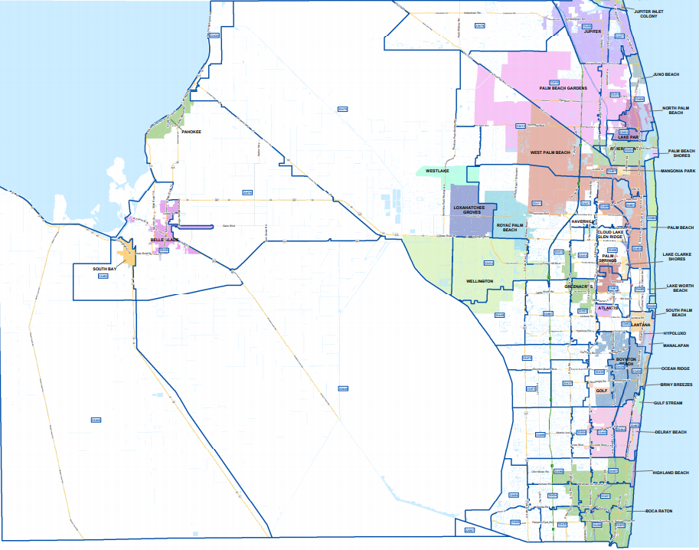
Notes:
The Red stars are the high priority areas that were previously identified.

Slide 12
Notes:
District 6 and District 7 are associated with the high priority zip codes previously identified.

Slide 13
SERVICES PROVIDED

Slide 14
Notes:
PBC hosted community conversations to identify what the community needs were in relation to poverty. Housing was a recurring theme during these conversations. As you can see in this graph, housing is the number one service we provide to our participants. Housing services include deposits, emergency rental assistance, and moving costs.
Other needs identified in the community conversations were transportation, utilities, childcare, and employment. As you can see SOFI agencies provide all of these services in their venture to pull people out of poverty and into self-sufficiency.
In addition to the initial needs assessment conducted, SOFI continues to host focus groups to glean further information on gaps and continued needs. The most recent focus group was conducted on November 5th with Pathways to Prosperity SOFI participants. This conversation led us to understand that education (college education and job training) were gaps in services. Through this conversation, we’ve been able to connect Pathways to Prosperity with our Community Action Program that provides job training.

Slide 15
QUALITATIVE DATA COLLECTION
Hosting focus groups quarterly engaging SOFI participants and community at-large in poverty elimination work
Focus groups glean qualitative information about barriers faced by families along with additional services needed
Allowing us to:
Identify policies that prevent families from earning more in order to write new policy initiatives aimed at eliminating poverty
Target specific organizations for partnerships that can provide the necessary supports for our families
Notes:
FOCUS GROUP INFORMATION

Slide 17
64 Families

Slide 18
Success Stories
FY 20
Cohort #1
Agency | % of families increasing income | Median $ increased | Median % increased
Urban League | 22% | $1,305.00 | 71%
Pathways to Prosperity | 41% | $1,480.00 | 100%
Community Action Program | 45% | $833.80 | 44%
Total | 31% | $1,305.00 | 71%
Notes:
The industry standard for poverty programming is 20% of families will increase household income.

Slide 19
ENGAGING B22 ALLIANCE
Notes:
Join our Economic Access and Poverty Workgroup – we meet on the 4th Thursday of every month
Activities include: planning advocacy work, increasing access to barriers for families, collaborating to solve this issues
Support our SOFI families by allowing access to services provided by B22 Alliance agencies
Provide paid internships and apprenticeships within your organizations to our families

Slide 20
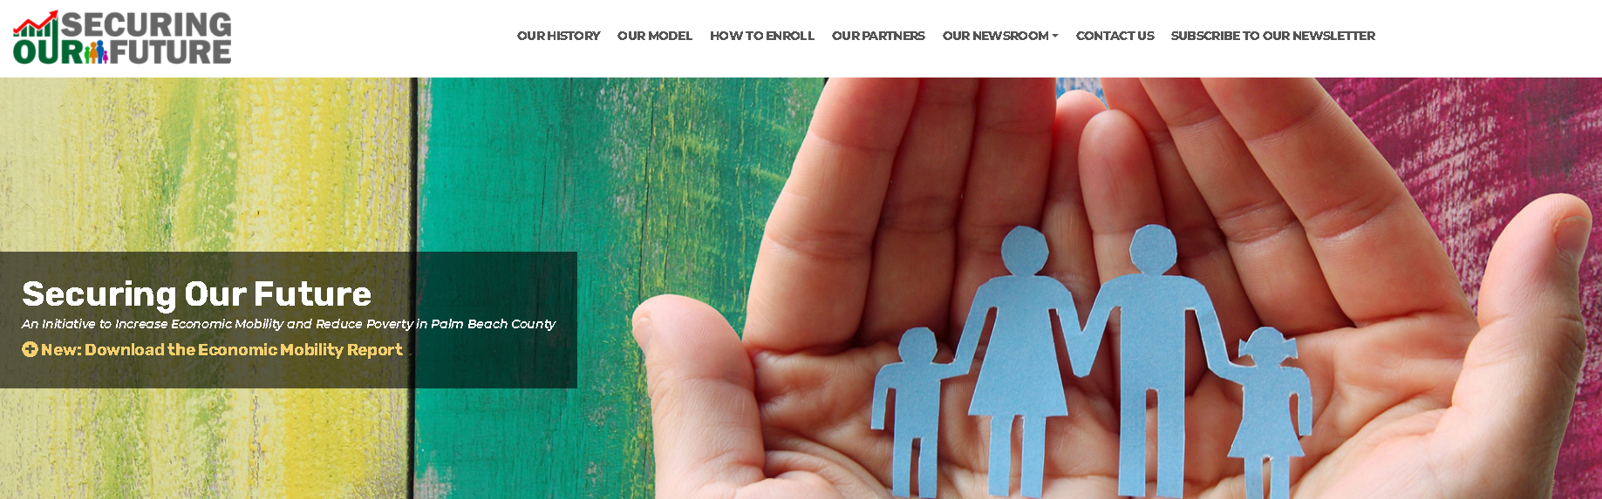
RESOURCES http://www.securingourfuturepbc.org/ Economic Mobility Report

